Slide 1
Automata Theory & Compiler Sess.
Lecture 01

Slide 2
Session Overview
Topic: Introduction to Flex and Bison
Goal: Set up environment and implement a basic lexical and syntax analyzer
By the end of this session, students will:
  Understand what Flex and Bison are
  Set up Flex and Bison on Windows (Code::Blocks + MinGW)
  Write and run a simple program that parses and evaluates arithmetic assignments

Slide 3
What is compiler?
A compiler is a special program that translates a high-level programming language (like C, Java) into machine code (low-level language) that a computer can understand.
Example: int a = b + c; → converted into assembly/machine code

Slide 4
Phases of a compiler
Phase | Description
1. Lexical Analysis | Breaks code into tokens (keywords, identifiers) using patterns
2. Syntax Analysis | Checks grammar using parsing (derives parse tree)
3. Semantic Analysis | Checks meaning (e.g., type checks)
4. Intermediate Code Generation | Creates platform-independent code
5. Optimization | Improves performance, removes redundancy
6. Code Generation | Converts into target language (e.g., x86)
7. Code Linking & Assembly | Final binary or executable

Slide 5
What is flex?
Flex stands for Fast Lexical Analyzer Generator.
It generates a scanner (lexer) from .l files.
It breaks input text into tokens using regular expressions.
Think of it like "reading code word by word.“
Example:
  [0-9]+ → NUMBER
  [a-zA-Z_][a-zA-Z0-9_]* → IDENTIFIER

Slide 6
What is bison?
Bison is a parser generator.
It processes the tokens provided by Flex and applies grammar rules.
It helps us understand structure and hierarchy in code.
Example:
  expression → expression + expression

Slide 7
Regular Expression (Regex)
A compact way to describe patterns in text.
Used in lexical analysis to match identifiers, numbers, etc.
Pattern | Matches
[0-9]+ | Numbers
[a-zA-Z_][a-zA-Z0-9_]* | Identifiers
[\t\n ]+ | Whitespace

Slide 8
Common Regex Symbols Used in Lexical Analysis
Symbol | Meaning | Example | Matches
[] | Matches any one character inside the brackets | [abc] | 'a', 'b', or 'c'
- (inside []) | Denotes a range of characters | [0-9] | Any digit from 0 to 9
+ | Matches one or more of the previous pattern | [0-9]+ | 5, 123, 007
* | Matches zero or more of the previous pattern | [a-z]* | "", hello, abcde
. | Matches any single character (except newline) | . | a, 1, #, etc.
^ (inside []) | Negates the character class | [^0-9] | Any non-digit character
? | Matches zero or one of the previous pattern | [0-9]? | "", 5
() | Groups expressions | (ab)+ | ab, abab, ababab
| | Logical OR (either this or that) | a|b | 'a' or ‘b’ but not both at the same time

Slide 9
Example: A Simple Statement Parser
Let’s say the user writes the following code:
x = 5 + 3;
Step 1: Lexical Analysis using Flex
Step 2: Syntax Analysis using Bison

Slide 10
Step 1: Lexical Analysis using Flex
Flex reads the input character by character and breaks it into tokens using regular expressions.
Input | Token Type | Value
x | IDENTIFIER | "x"
= | SYMBOL | '='
5 | NUMBER | 5
+ | SYMBOL | '+'
3 | NUMBER | 3
; | SYMBOL | ';'

Slide 11
Step 1: Lexical Analysis using Flex
This is handled by rules in scanner.l, like:
[0-9]+ → return NUMBER;
[a-zA-Z_][a-zA-Z0-9_]* → return IDENTIFIER;
"+" → return '+’;

Slide 12
Step 2: Syntax Analysis using Bison
Bison takes these tokens and matches them against grammar rules to check if the structure is valid.
The rule:
statement:
  IDENTIFIER '=' expression ‘;’
For expression:
expression:
  NUMBER | expression '+' expression
So, x = 5 + 3; matches:
  IDENTIFIER '=' (NUMBER '+' NUMBER) ';’
  → OK!
Output:
  Assign 8 to x

Slide 13
summary
Flex: Fast lexical analyzer generator (tokenizes input text)
Bison: GNU parser generator (parses structured input)
Flex ≈ Lex (Lexical analysis)
Bison ≈ Yacc (Yet Another Compiler Compiler)
Used in compiler front-end (lexical + syntactic analysis)

Slide 14
System Requirements
Code::Blocks IDE (with MinGW)
win_flex & win_bison (Windows ports of Flex & Bison)
Basic understanding of C

Slide 15
Environment Setup
Install Code::Blocks (with MinGW)
Download win_flex_bison (e.g., https://github.com/lexxmark/winflexbison/releases)
Extract the ZIP, copy these files to C:\ :
  win_flex.exe
  win_bison.exe
Add path to Environment Variables:
  Control Panel → System → Environment Variables
  Edit Path → Add path to folder containing win_flex.exe and win_bison.exe

Slide 16
Verify Installation (Command Prompt)
win_flex --version
win_bison --version
Both should show version info

Slide 17
Creating the Project
Open Code::Blocks → File → New → Console Application
Choose C language
Project name: Week01FlexBison (Anything else)
Save in desired location (E:\ATC Sessional\Week01FlexBison)

Slide 18
Create Input Files
Create two new files inside the project directory:
scanner.l → the Flex file (lexer)
parser.y → the Bison file (parser)
Do not compile these files directly — we’ll use Flex and Bison manually.

Slide 19
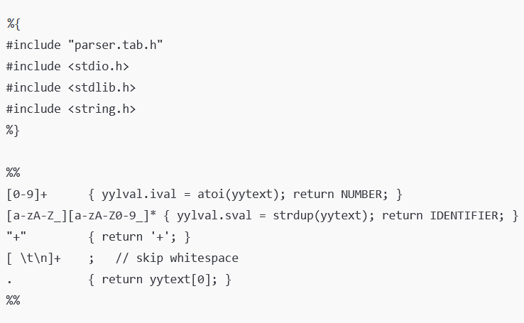
Sample scanner.l
Header Section
This header is generated by Bison and contains token definitions (like NUMBER, IDENTIFIER) and yylval.
}
Standard libraries for I/O, memory, and string manipulation.
Rules Section

Slide 20
Sample scanner.l
yytext: A global char* holding the matched text (e.g., "123").
atoi(yytext): Converts the matched string to an integer.
yylval.ival: Stores the integer in the yacc (Bison) semantic value union.
return NUMBER: Returns the token NUMBER to the parser.
strdup(yytext): Duplicates the string (allocates memory and copies text).
yylval.sval: Stores the string value for the parser to use.
return IDENTIFIER: Returns IDENTIFIER token to Bison.
Returns '+' as a character token (Bison treats single-character tokens like +, =, ; directly).
return yytext[0];: Returns the actual character matched. Useful for operators like =, ;, *, etc. that are handled directly by their character in the parser.

Slide 21
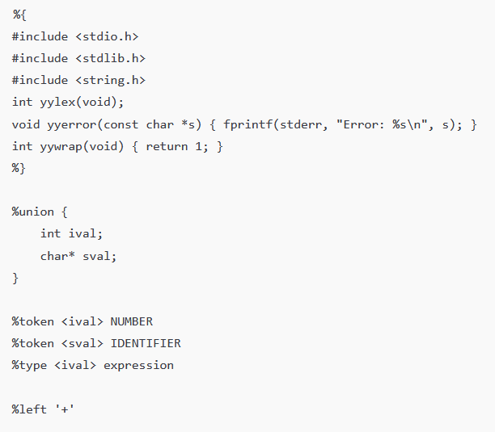
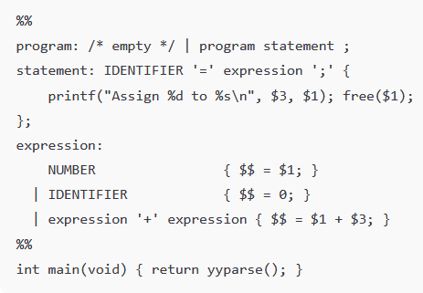
Sample parser.y
Header Section
Grammar Rules Section
This is the start symbol. It defines a program as: empty, or a sequence of statements. This allows parsing multiple statements.
Declaration of the scanner function (defined in scanner.l).
Called by Bison to report syntax errors.
Tells the scanner when to stop reading input (1 = no more input).
$1 = the identifier (e.g., "x")
$3 = the result of the expression on the right-hand side (e.g., 5)
free($1);: Frees the dynamically allocated memory from strdup() in the scanner.
Declare the Union for Semantic Values
Defines a union named yylval to carry semantic values between lexer and parser.
A single number just evaluates to its value.
Declare Tokens and Types
Treated as 0 for simplicity
Tells Bison that the NUMBER token carries an int value.
Tells Bison that IDENTIFIER carries a char* (string).
Evaluates a + b by adding the two sub-expressions.
The non-terminal expression will evaluate to an int.
Operator Precedence and Associativity
Defines + as a left-associative operator.
The entry point of the program.
yyparse() starts the parsing process, calling yylex() to get tokens and applying grammar rules.

Slide 22
Generate Output Files
From CMD (in project folder):
  win_bison -d parser.y → generates parser.tab.c, parser.tab.h
  win_flex scanner.l → generates lex.yy.c
Add these 2 files to Code::Blocks project:
  parser.tab.c
  lex.yy.c
Delete default main.c

Slide 23
Build and Run
Input:
x = 5 + 10;
a = 4;
Output:
Assign 15 to x
Assign 4 to a

Slide 24
Functions Summary
Function | Role | Defined Where | Called By
yylex() | Returns tokens using regex | Generated by Flex (scanner.l) | Called by yyparse()
yyparse() | Main parser loop | Generated by Bison (parser.y) | Called by main()
yyerror() | Handles syntax errors | Defined in parser.y | Called by yyparse()
yywrap() | Signals end of input | Defined | Called by yylex()

Slide 25
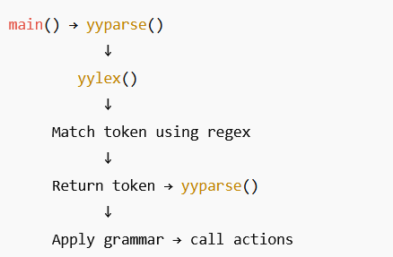
How it works?

Slide 26
Summary
Concepts:
  Lexical vs Syntactic Analysis
  Tokenizing with Flex
  Parsing with Bison
Skills:
  Installed & configured tools
  Created and linked lexer/parser
  Ran a working arithmetic parser

